Slide 1
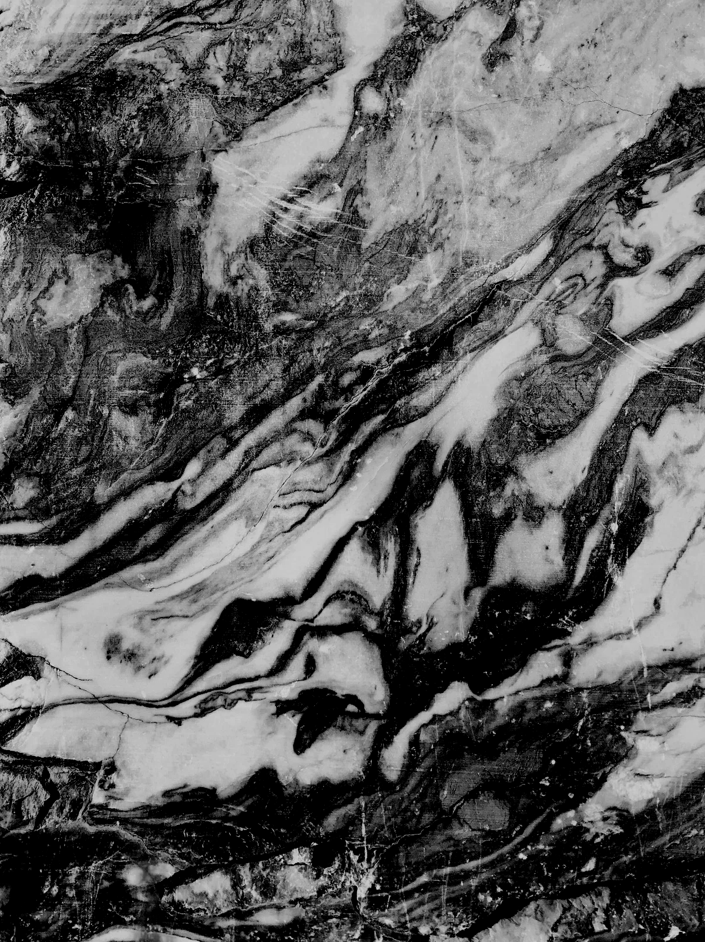
01
Expert System for Risk Management
A Case Study: Comparing Knowledge Representation Schemes

Slide 2
  Case Study: Risk Management in Construction.
  Expert System Components & implementation steps.
  Inference Mechanisms: Forward vs. Backward Reasoning.
  Knowledge Representation Schemes (Simple, Structured, Frame, Logic).
  Final Conclusion.
02
Presentation Agenda
AI in Construction Risk Management

Slide 3
The Problem: Risk in Construction
03
  Large construction projects face complex, interrelated risks (Financial, Legal, Managerial).
  Traditional management relies on human experts who may overlook critical "Causal Chains."
  System Goal: Predict risks before they occur (Forward) OR analyze the root cause of an existing problem (Backward).
  Challenge: Finding the best "Knowledge Representation" to make the system fast and scalable.
AI in Construction Risk Management

Slide 4
04
Why Build this Expert System?
The Problem :
  Project managers face critical issues: Delays, Cost Overruns, and Quality Defects.
  These are caused by: Administrative errors, complex laws, and client-related issues.
  The Reality: Risk relationships are too complex for human memory alone due to the massive number of scenarios.
The Solution :
  Proactive Prediction: Identifying risks before they occur (Forward Thinking).
  Diagnostic Analysis: Root-cause analysis for problems that already happened (Backward Thinking).
  Decision Support: Automating the "Causal Chain" to assist managers in high-pressure environments.
AI in Construction Risk Management

Slide 5

05
SystemComponents: Risk Management Expert System
  Knowledge Base: Stores construction-specific "Causal Chains" (Causes, Rules, and Risks).
  Inference Engine: The processing core that links causes to risks using Forward & Backward reasoning.
  User Interface: Portal for entering project symptoms and receiving "Risk Alarms" or explanations.
  Maintenance Tool: Allows experts to update risk rules easily as market regulations change.
AI in Construction Risk Management

Slide 6
AI in Construction Risk Management
06
KNOWLEDGE ACQUISITION:
ENGINE DEVELOPMENT:
Gathering risk-related rules from construction domain experts
Coding the Inference Engine to navigate the data (Forward &
SCHEME SELECTION:
SYSTEM VALIDATION:
Choosing the best representation (Frame, Rules, or Logic) based on project complexity.
Testing the system accuracy using real-world construction case scenarios
KNOWLEDGE MODELING:
Transforming raw expertise into the chosen format
Implementation Steps

Slide 7

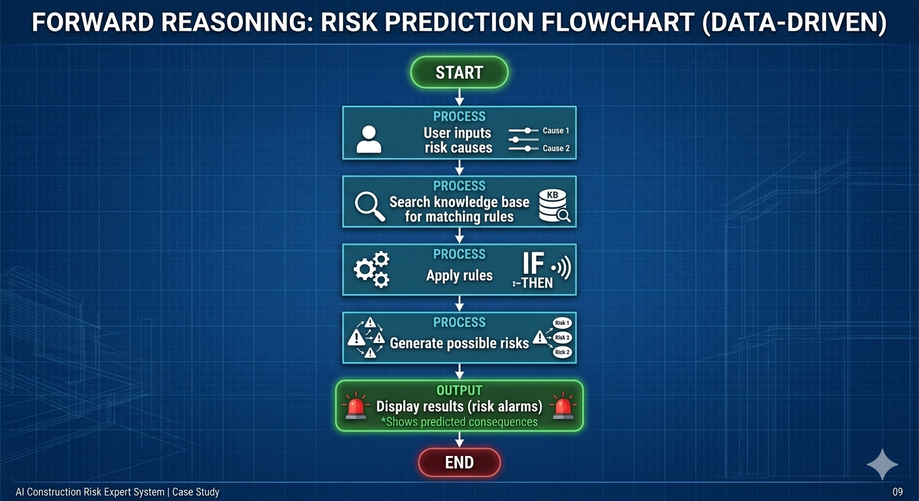
07
Forward Reasoning (Data-Driven)
  Concept: Starts from Known Facts (Causes) to reach New Conclusions (Risks).
  Usage: Used for Risk Prediction — "If these problems exist, what will happen next?"
  Direction: From Left to Right (Symptoms → Outcome).
AI in Construction Risk Management

Slide 8
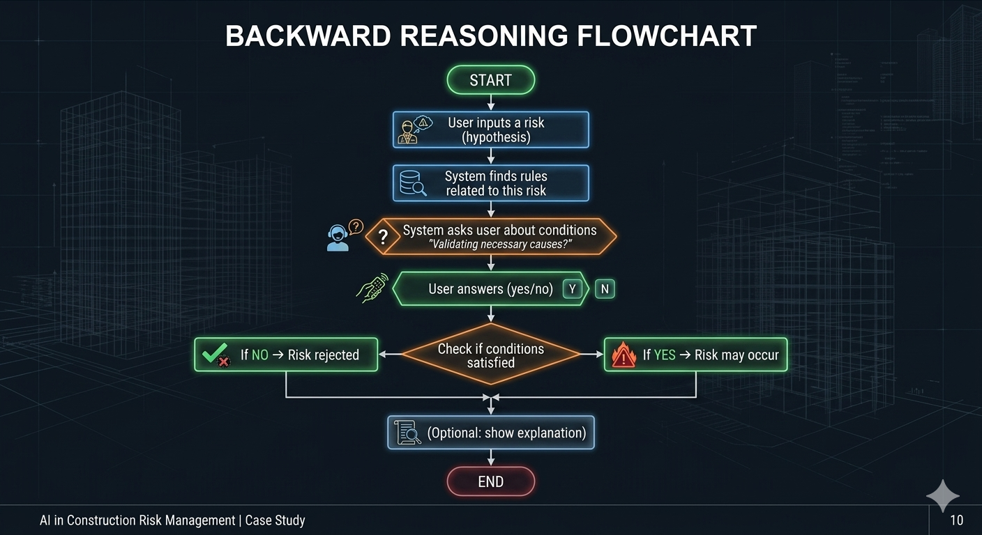
08
Backward Reasoning (Goal-Driven)
  Concept: Starts from a Specific Goal (Risk) and works backward to find the Root Causes.
  Usage: Used for Risk Validation — "This risk happened, but what exactly triggered it?"
  Direction: From Right to Left (Outcome → Evidence).
AI in Construction Risk Management

Slide 9
09
Why We Use Both?
The System combines Forward & Backward to cover the full Project Lifecycle:
  Forward (Predictive):
    Function: Inputs causes → Predicts future risks.
    Goal: "Early Warning" to avoid disasters before they happen.
  Backward (Diagnostic):
    Function: Inputs a risk → Validates root causes.
    Goal: "Root-Cause Analysis" to understand why a failure occurred.
AI in Construction Risk Management

Slide 10
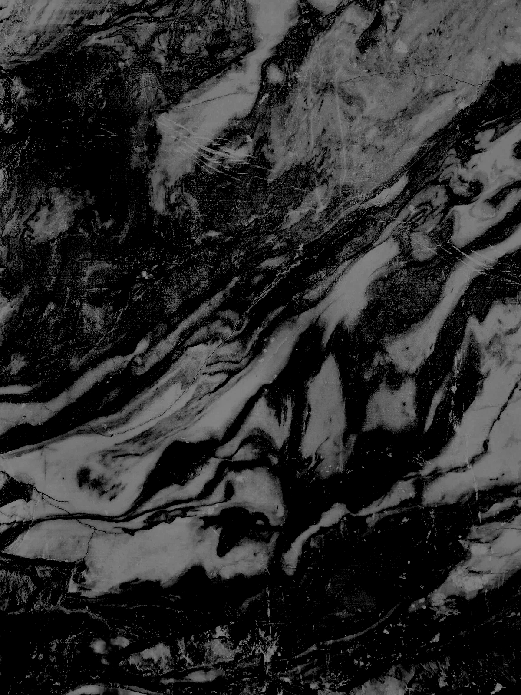
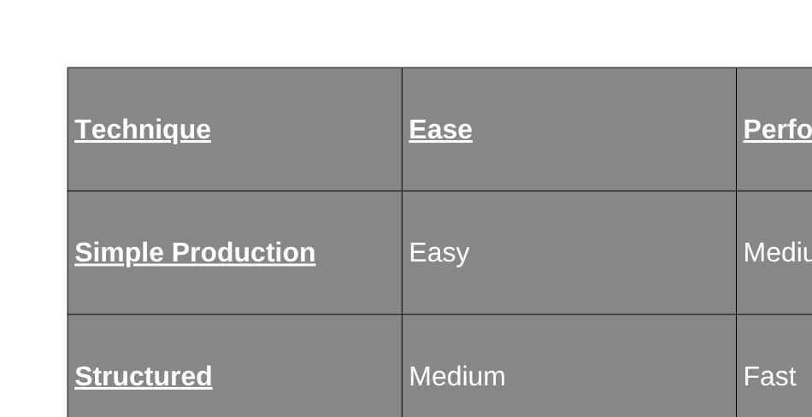
Comparative Analysis of Knowledge Representation Schemes
10

Slide 11



11
which
technique
we choose?
"Although Frame systems provide better performance, we chose a Simple Production System because our system is small and easier to implement."
AI in Construction Risk Management

Slide 12


  The Objective: We proposed an Expert System designed to handle the complex causal relationships in construction risk management.
  Mechanism: The system's strength lies in combining Forward and Backward reasoning to provide both prediction and diagnosis tools.
  Technique: We utilized a Simple Production system (IF-THEN rules) to ensure the logic is easy to implement, understand, and maintain.
  Final Impact: This approach transforms expert human knowledge into a structured digital tool that assists project managers in making faster, data-driven decisions
AI in Construction Risk Management
Conclusion
12

Slide 13

13
THANKS
For Your Attention.
AI in Construction Risk Management

