Slide 1
Agricultural guidance

Slide 2
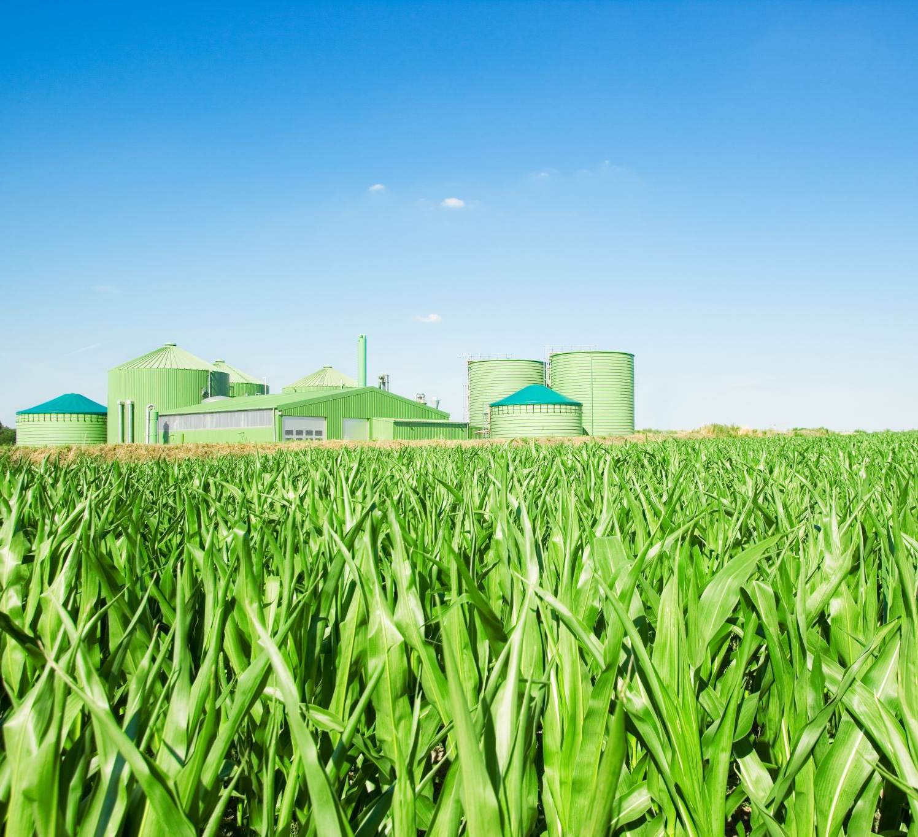
Objective:
The web application aims to address agricultural problems, specifically the misuse and conversion of agricultural land into non-agricultural purposes. The application will track agricultural land, manage crop types and quantities, regulate pesticide and fertilizer usage to reduce pollution and land wastage, and control the buying and selling of agricultural land.

Slide 3
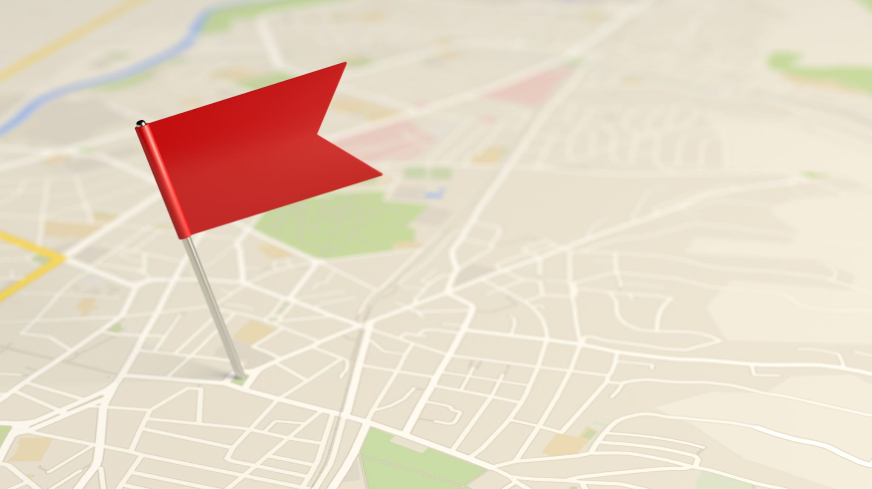
Features and Implementation
1. Agricultural Land Management
Feature: Track agricultural land, owners, and environment details.
Implementation:
Frontend:
Form: Input fields for land size, owner names, and environmental data.
Map Integration: Use maps to visualize land locations and details.
Backend:
Database: Store land details, owner information, and environmental data.
API: Endpoints to manage land data and retrieve information.

Slide 4
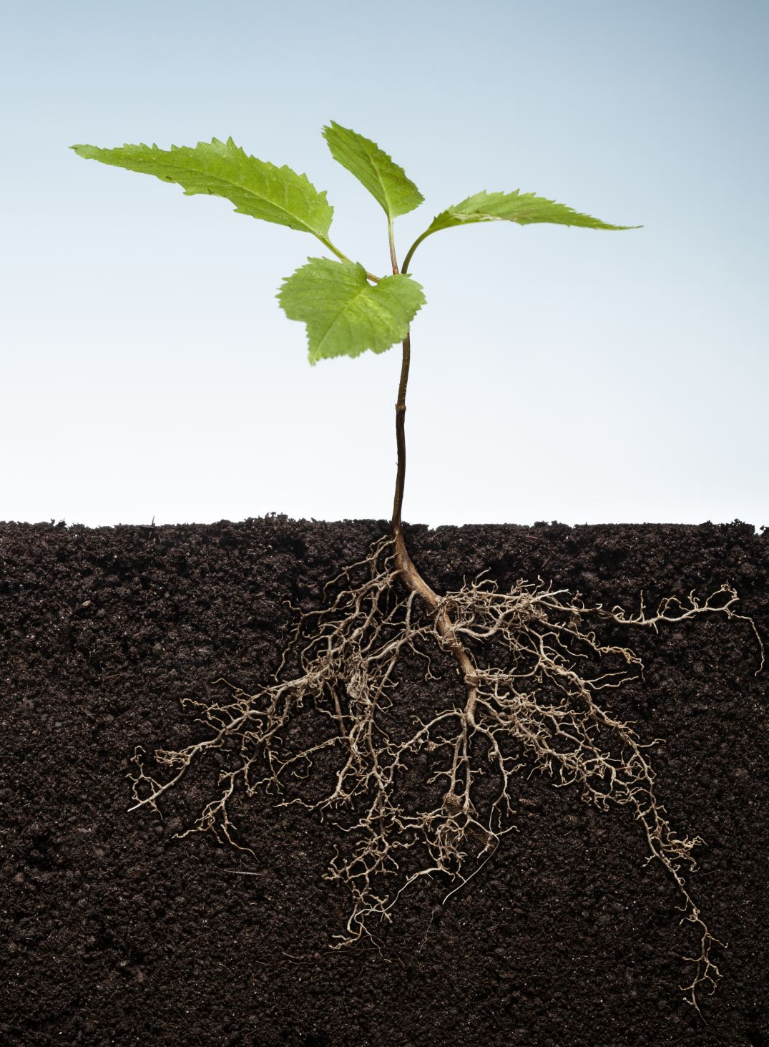
2. Crop Management Feature: Determine and track crop types and quantities for each land. Implementation: Frontend: Interface: Forms and tables to input and view crop data. Backend: Database: Store crop types, quantities, and related details. Algorithm: Use decision trees or random forests to recommend suitable crops based on land environment data. 3. Pesticide and Fertilizer Management Feature: Regulate the use of pesticides and fertilizers to minimize pollution. Implementation: Frontend: Forms: Input fields for specifying types and quantities of pesticides and fertilizers. Backend: Database: Store data on pesticide and fertilizer usage. Algorithm: Utilize clustering or optimization algorithms to recommend optimal usage levels to reduce pollution.

Slide 5
4. Land Buying and Selling Management
Feature: Control and regulate the buying and selling of agricultural land.
Implementation:
Frontend:
Form: Input fields for buying and selling land, including details like land size, price, buyer/seller information.
Market Overview: Interface to view available lands for sale and recent transactions.
Backend:
Database: Store transaction details, buyer and seller information, and land status.
API: Endpoints to manage buying/selling requests and update land status.
Approval System: Implement a system where transactions must be approved by relevant authorities to prevent misuse.

Slide 6
Technologies and Tools
Frontend
Frameworks: React, Vue, or Angular for building dynamic interfaces.
Libraries:
Form Handling: Formik or React Hook Form for handling form submissions.
Map Integration: Leaflet or Google Maps API for visualizing land data.
Backend
Frameworks: Node.js with Express or Django for building robust APIs.
Database:
Relational: PostgreSQL or MySQL for structured data.
NoSQL: MongoDB for flexible data storage.
Authentication: OAuth or JWT for secure user authentication.

Slide 7
Machine Learning/Deep Learning
Libraries:
scikit-learn: For traditional machine learning algorithms like decision trees and random forests.
TensorFlow/Keras: For building deep learning models if needed.
XGBoost: For gradient boosting algorithms.
Models:
Decision Trees/Random Forests: For crop recommendation based on environmental data.
K-Means Clustering: For segmenting land based on similar characteristics.
Data Processing and Analysis
Libraries:
pandas: For data manipulation and analysis.
NumPy: For numerical operations.
SciPy: For scientific computing.
Visualization
Libraries:
Matplotlib/Seaborn: For creating visualizations of agricultural data.
Plotly: For interactive and dynamic data visualizations.
Additional Considerations
Security: Implement robust security measures to protect user data and ensure the integrity of the system.
Scalability: Design the application to handle a large number of users and data efficiently.
User Experience: Focus on creating an intuitive and user-friendly interface to encourage user engagement.
Accessibility: Ensure the application is accessible to users with disabilities.

Slide 8
By incorporating these features and technologies, the web application can effectively track agricultural land, manage crop types and quantities, regulate pesticide and fertilizer usage, and control the buying and selling of agricultural land to address critical agricultural issues.

Slide 9
Any Question

