Slide 1
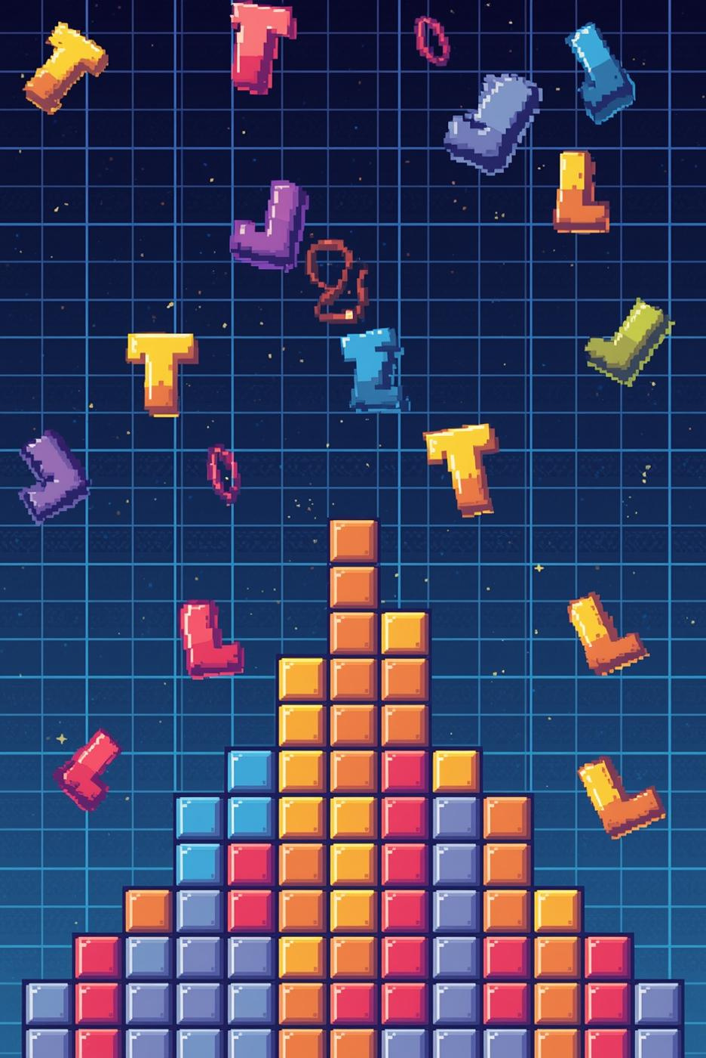
Building a Tetris Game in Pygame

Slide 2


Game Setup & Configuration
Board Dimensions
Pygame Initialization
Cell Size
30 pixels per grid cell for rendering.
10 columns × 20 rows for classic Tetris proportions.
Screen display set to 300×600 pixels with game loop running at 60 FPS.

Slide 3
Shape Class: Movement & Collision
Position Tracking
Movement Methods
Boundary Detection
Coordinate Retrieval
Each shape stores x, y coordinates and color (RGB tuple).
move_down(), move_left(), move_right() adjust coordinates by 1 unit.
is_inside_board() validates position within 0-9 columns and 0-19 rows.
get_coordinates() returns shape position for rendering and collision checks.

Slide 4
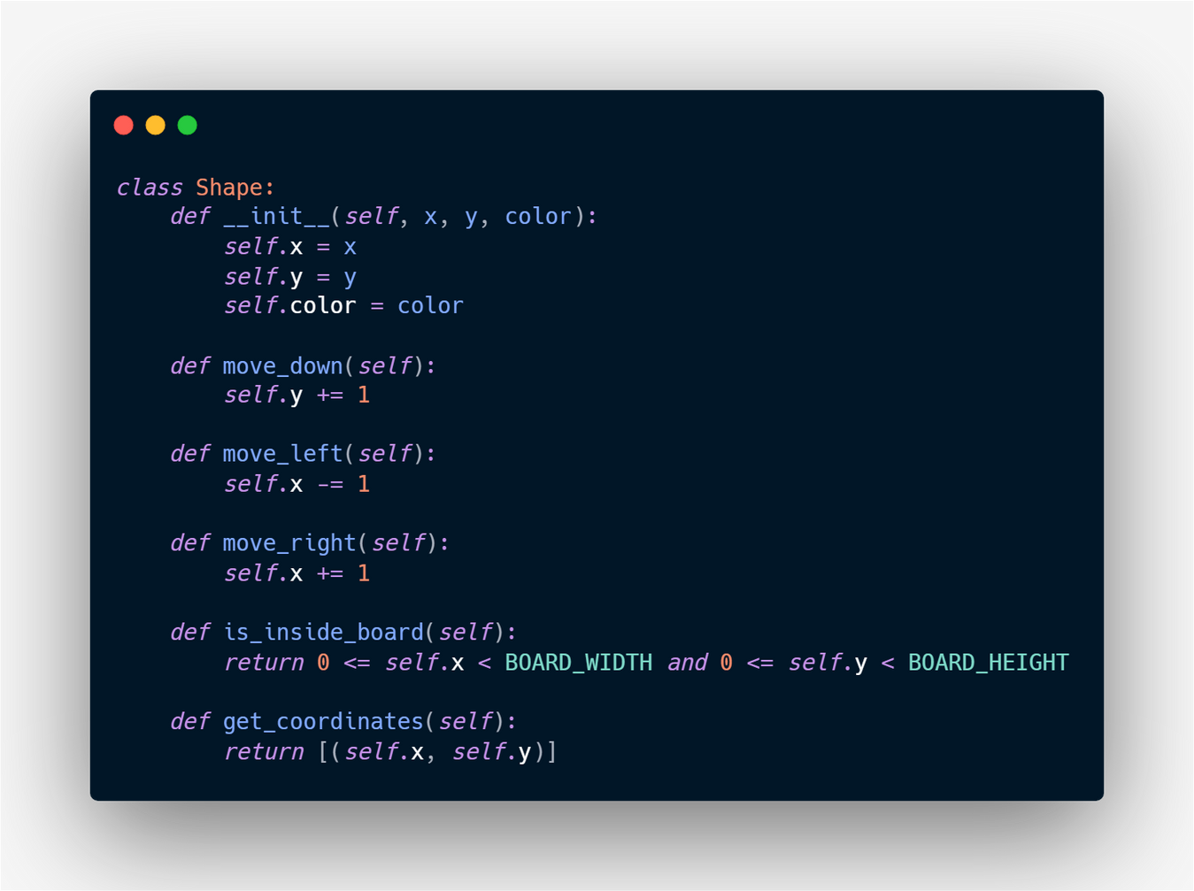
Shape Class Code

Slide 5
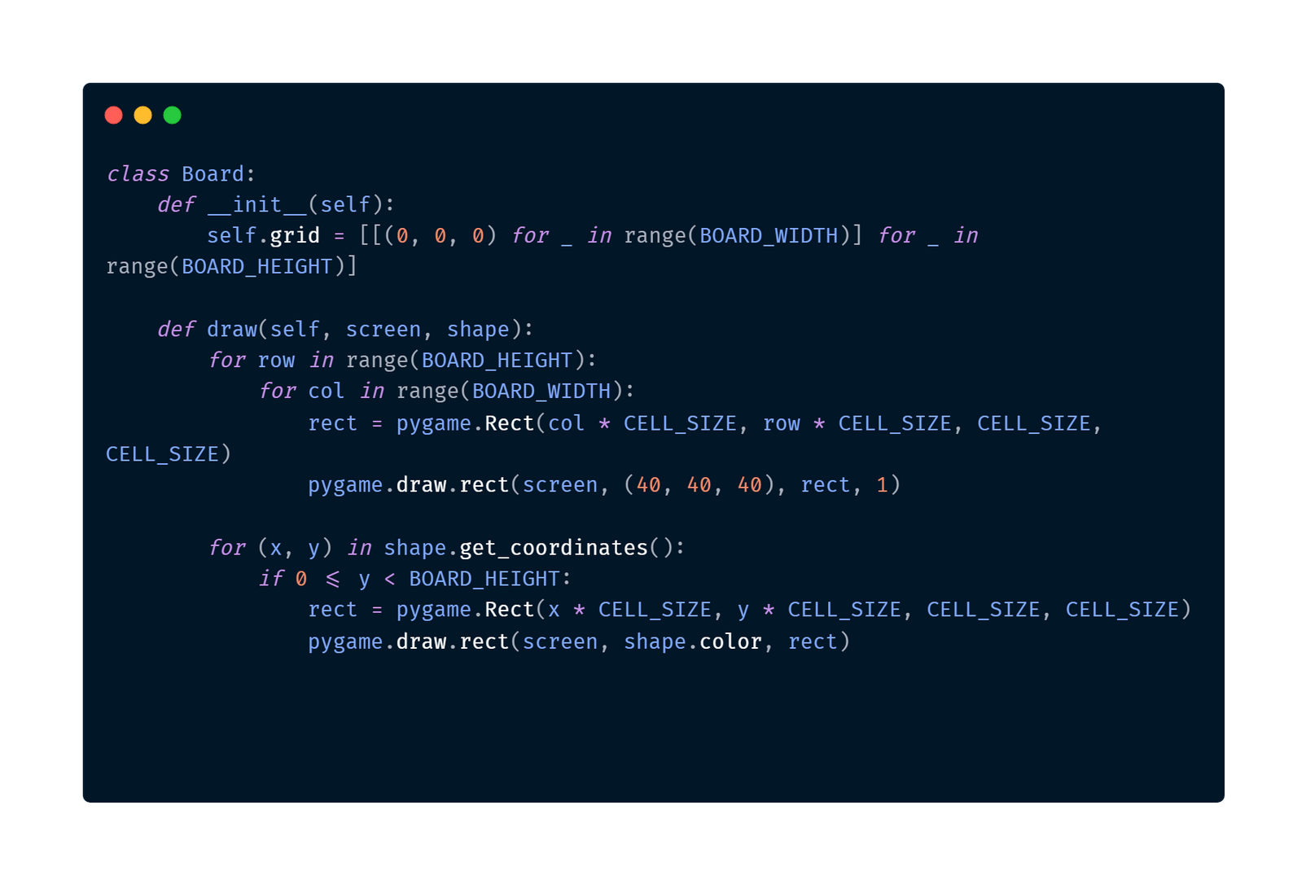
Board Class: Grid & Rendering
Grid Storage
2D array (20×10) stores RGB color tuples for each cell. Initialized with black (0,0,0).
Draw Method
Renders grid lines in dark gray, then draws active shape in its color at calculated pixel positions.

Slide 6
Game Loop: Input & Physics
Gravity System
Keyboard Input
Collision Response
Screen Update
Shape falls every 500ms. fall_time accumulates delta time each frame.
LEFT/RIGHT arrows: move shape horizontally;
DOWN: accelerates descent.
After each move, is_inside_board(): validates. Invalid moves are reversed immediately.
Fill screen black, draw board with shape, flip display at 60 FPS.

Slide 7
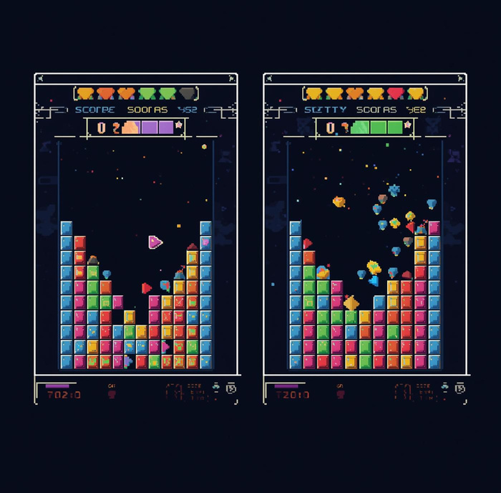
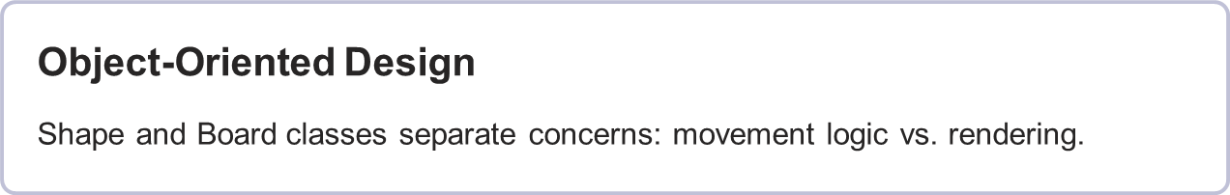
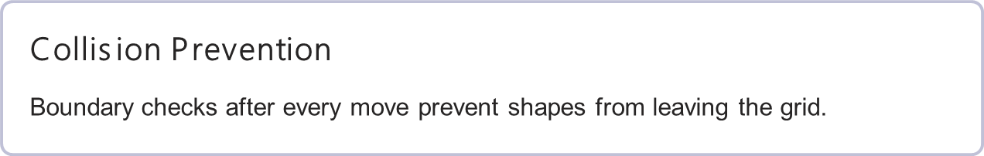
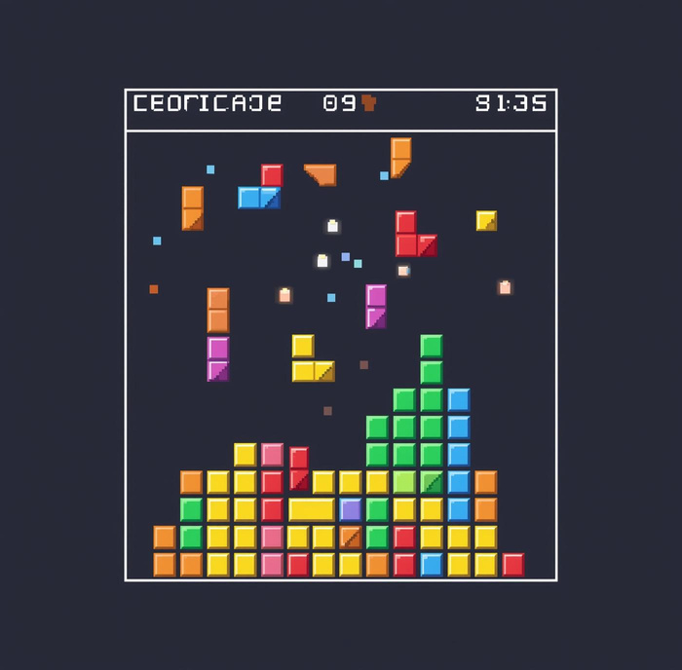
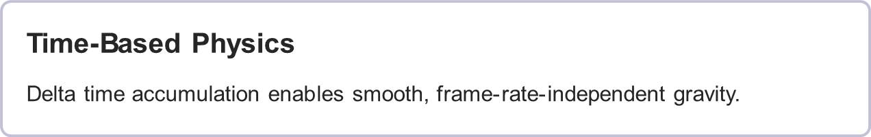

Key Takeaways

Slide 8
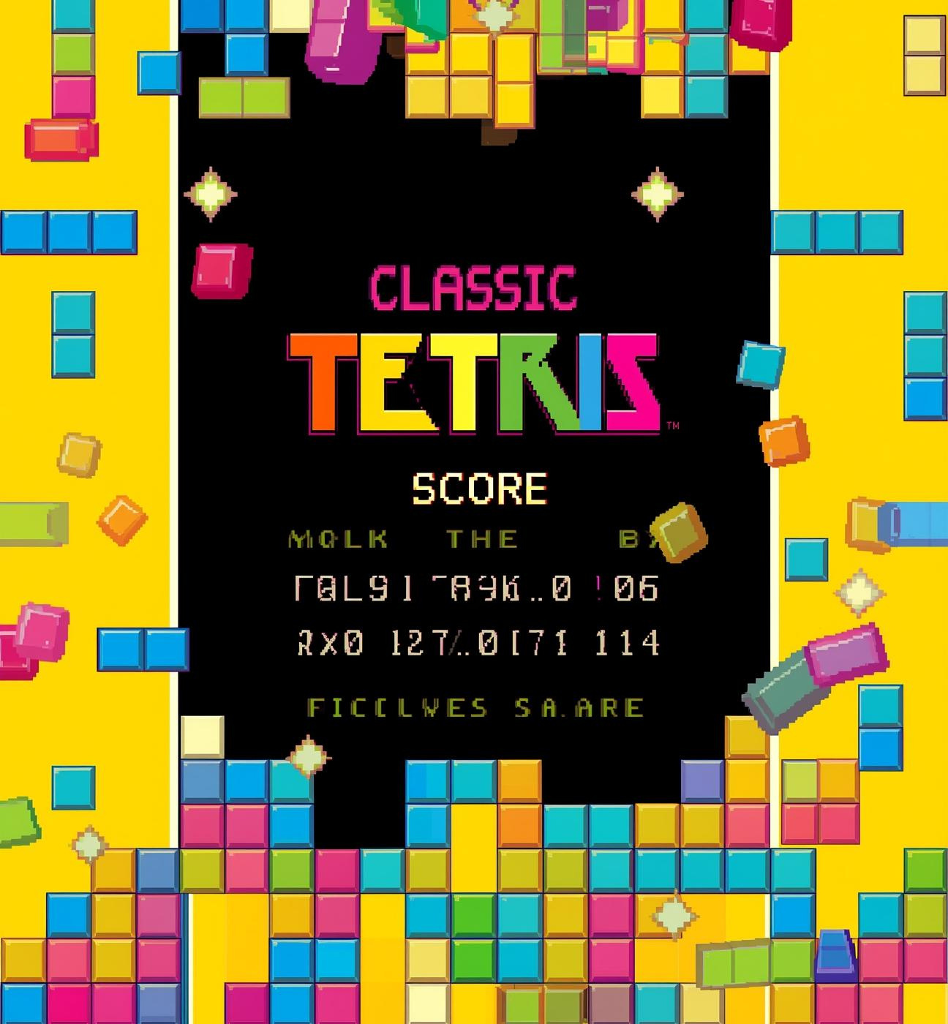
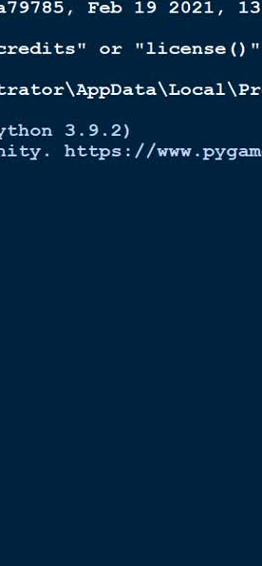
GamePlay

